Slide 1
Outbreak investigation
EMD 531
Lecture 14
nathan grubaugh, phd

Slide 2
Learning objectives
Students will be able to:
Understand how pathogen genomics can aid outbreak investigations.
”Read” a phylogenetic tree to estimate important outbreak parameters.
Appreciate the need for openness and effective communication.
Interpret virus genomic data from COVID-19 outbreak (activity)
Open Q&A on exercises

Slide 3
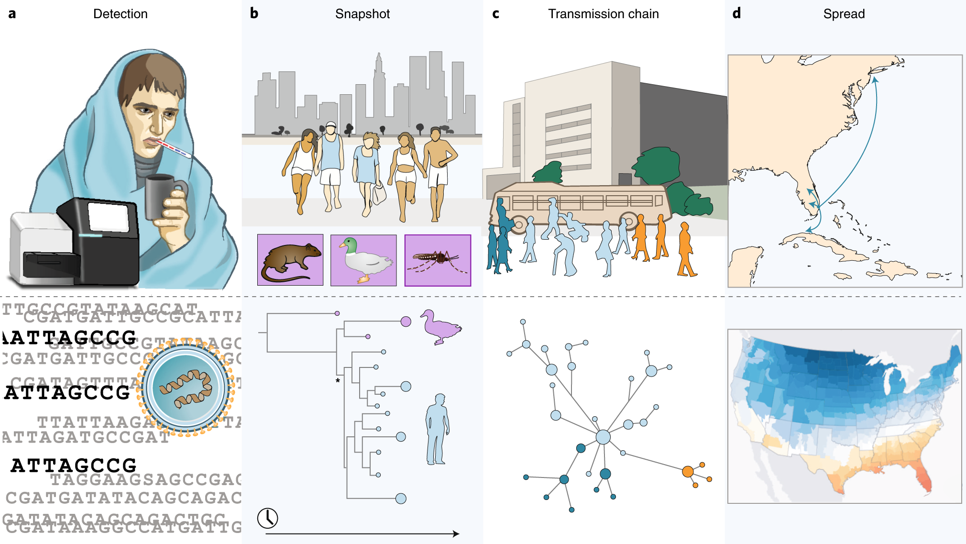
Pathogen genomic applications
Grubaugh et al., 2019. Tracking virus outbreaks in the twenty-first century. Nature Microbiology

Slide 4
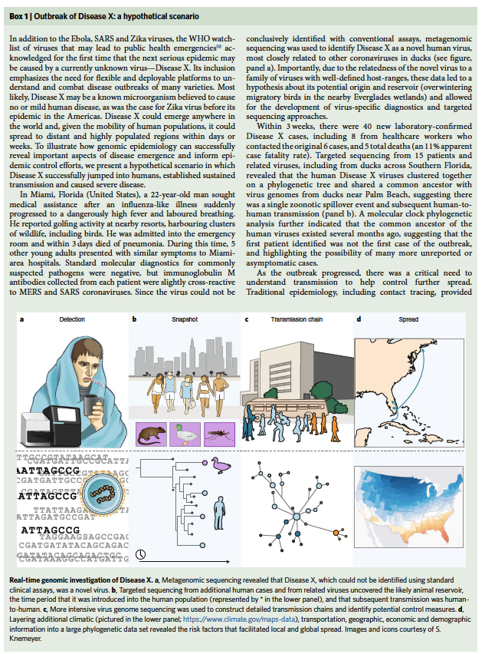
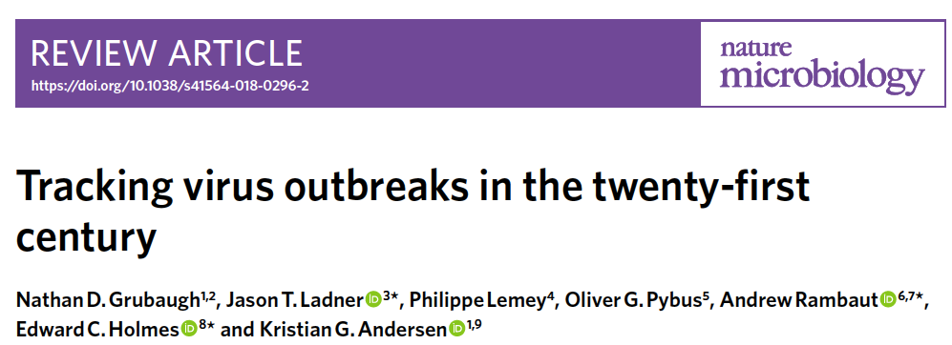

Slide 5
Genomic applications during outbreaks

Slide 6

“Fog of war”
At the start of an outbreak, we often do not know:
Extent of the outbreak
Timing and nature of source
How it is being transmitted

Slide 7
Lifting the ”fog” during early outbreaks
Measure diversity and relatedness of pathogens from as many cases as possible
Genetic relatedness (how transmitted and nature of source)
Evolutionary rate (timing of outbreak)
Genetic diversity (extent of outbreak)
Resistance (if known alleles/genetic markers)

Slide 8
Genetic relatedness
Compare to pathogen genomic sequences within outbreak and close relatives outside of outbreak
Determine source location
If zoonotic:
Determine source animal reservoir or intermediate host
Determine if transmission is human-to-human or from multiple animal “spillovers”

Slide 9
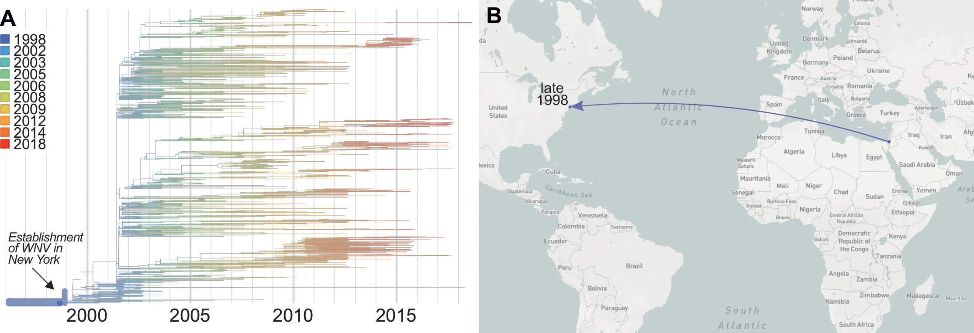
Genetic relatedness: source location
West Nile virus source in North America is likely in the Middle East
https://journals.plos.org/plospathogens/article?id=10.1371%2Fjournal.ppat.1008042

Slide 10
Genetic relatedness: reservoir + transmission
The animal reservoir of MERS-CoV is camels.
Clusters of human-to-human transmission, most new spillovers from camels.
https://elifesciences.org/articles/31257

Slide 11
Evolutionary rate (tMRCA)
Estimate the time of most common recent ancestor (tMCRA) = lower bound on when outbreak started.
If rate (“molecular clock”) is constant, can directly estimate.
If too early in outbreak and not enough diversity to estimate evolutionary rate, estimates based on rates rate from previous outbreaks or related viruses.
Determine how long pathogen circulated prior to discovery
“surveillance gap”

Slide 12
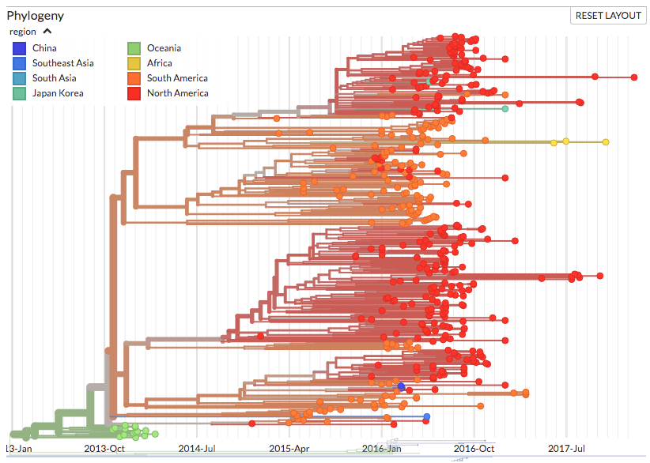
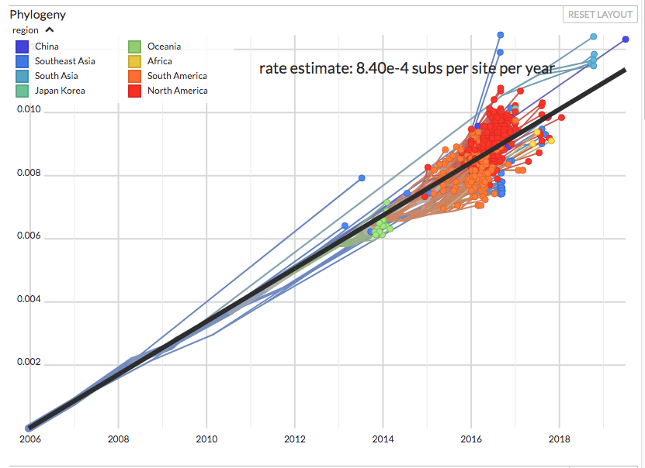
Evolutionary rate: tMRCA (constant rate)
Zika virus tMRCA in the Americas is August 2013 to February 2014
https://nextstrain.org/zika?c=region

Slide 13
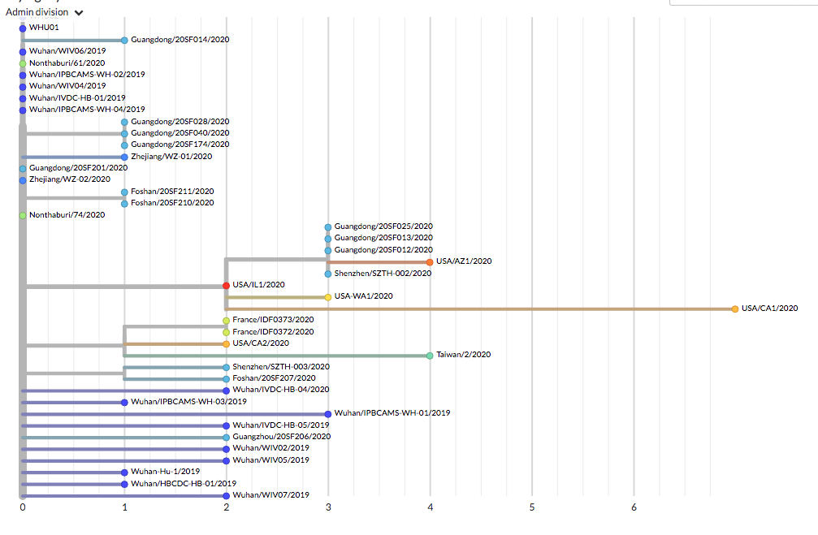
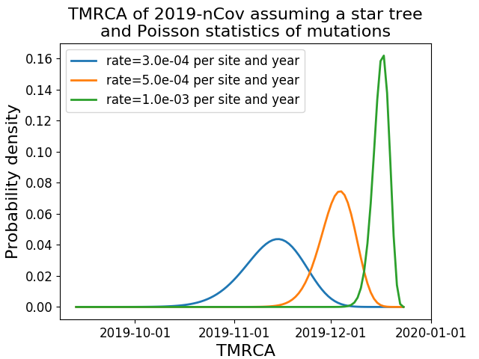
Evolutionary rate: tMRCA (estimated rate)
Use evo rates of SARS-CoV to date tMRCA of SARS-CoV-2 until enough data to estimate rate
https://nextstrain.org/narratives/ncov/sit-rep/2020-01-30

Slide 14
Genetic diversity
Average # of nucleotide differences among pathogens in a population
Diversity changes following outbreak patterns
“Shape” of the phylogenetic tree can provide insights into transmission
Patterns of lineage “birth-death” can provide estimates of R0
Combined with evolutionary rate, early indicator of outbreak size
In general: Older the tMRCA, larger the outbreak

Slide 15
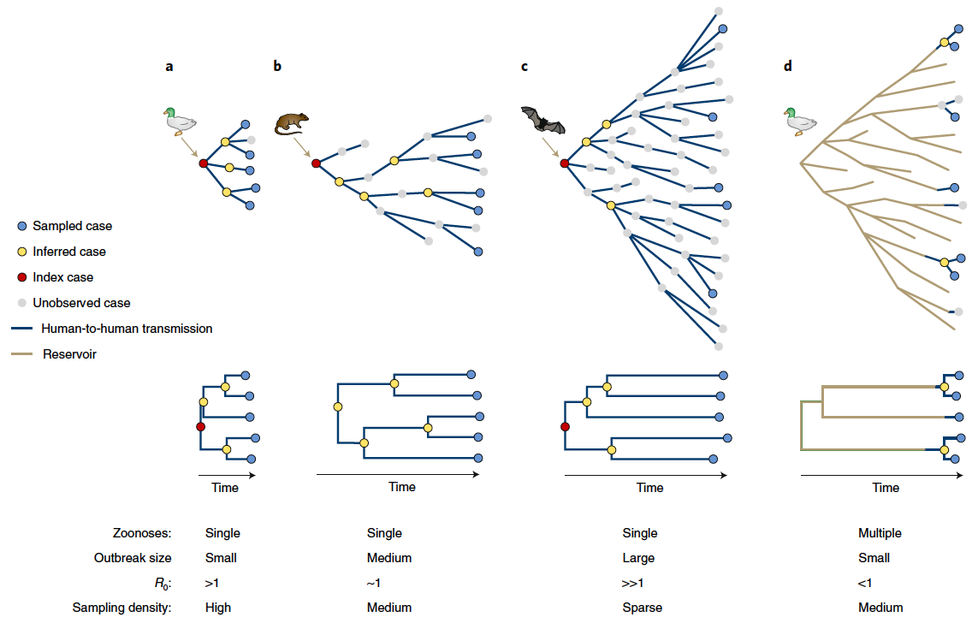
Genetic diversity – transmission intensity

Slide 16
Genetic diversity – transmission intensity

Slide 17
Genetic diversity – transmission intensity

Slide 18
Genetic diversity – transmission intensity

Slide 19
How much is enough genetic data?
Mostly a post-hoc analysis (but shouldn’t be!!)
Dependent on amount of circulating genetic diversity
Enough data when:
Can estimate evolutionary rate directly from the data
New genomes do not push back the tMRCA
Long branches have been resolved
New data should be added throughout course of outbreak/epidemic from all possible locations
As soon as you stop adding data, new long branches will form

Slide 20
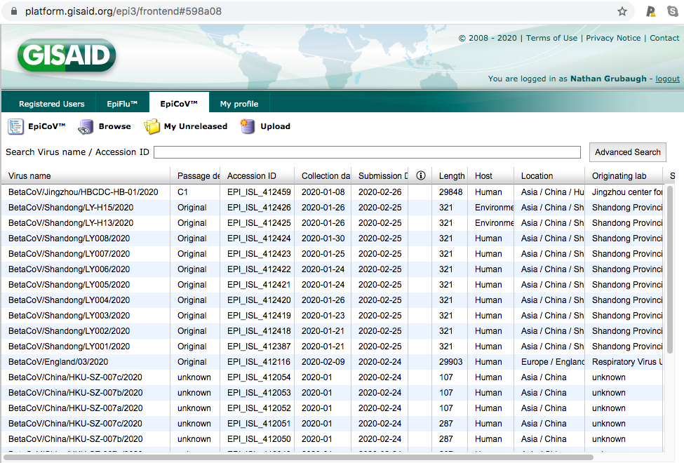
Data gaps can be resolved through openness

Slide 21
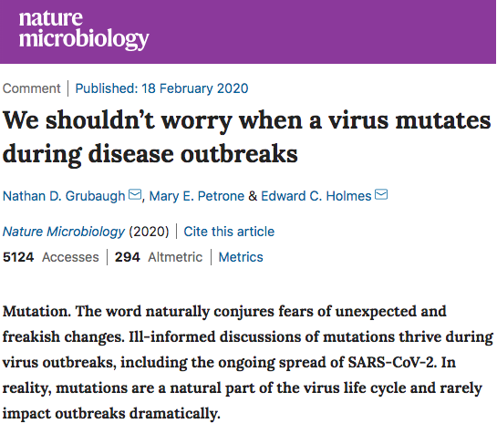

A source of misinformation

Slide 22
Class activity: COVID-19 outbreak

Slide 23
nextstrain.org/groups/blab/sars-like-cov
nextstrain.org/ncov
In groups, examine the phylogenetic data in both nextstrain pages
Discuss:
E.g. Origins/animal hosts; relatedness to SARS; number of introductions; tMRCA of outbreak; global spread; misinformation (e.g. came from a lab)
Construct at least 5 major conclusions
Include supporting evidence
Include explanation in language suitable for the general public

